Slide 1
20XC32 Microcontrollers and Embedded programming

Slide 2
8051 Timers and Counters

Slide 3
TIME DELAY FOR VARIOUS 8051 CHIPS
CPU executing an instruction takes a certain number of clock cycles referred as machine cycles
The length of machine cycle depends on the frequency of the crystal oscillator connected to 8051
In original 8051, one machine cycle lasts 12 oscillator periods
Find the period of the machine cycle for 11.0592 MHz crystal
frequency
Solution:
11.0592/12 = 921.6 kHz;
ONE machine cycle is 1/921.6 kHz = 1.085μs

Slide 4
TIME DELAY
There are two ways to create a time delay in 8051 C
Using the 8051 timer
Using a simple for loop
Three factors that can affect the accuracy of the delay
1. The 8051 design
The number of machine cycle
The number of clock periods per machine cycle
2.The crystal frequency connected to the X1 – X2 input pins
3. Compiler choice
C compiler converts the C statements and functions to Assembly language instructions
Different compilers produce different code

Slide 5
How to introduce time delay???

Slide 6
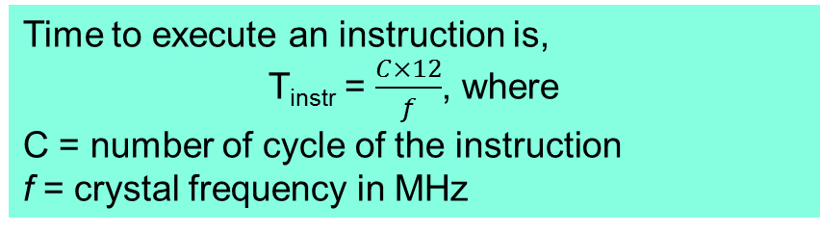
Time delay calculation
Instruction cycle
1 machine cycle = 12 clock pulses

Slide 7
Time Delay Calculations for 8051 Microcontroller
The 8051 microcontroller works with 11.0592 MHz frequency.
In original 8051, one machine cycle lasts 12 oscillator periods
Frequency f _{osc}= 11.0592MHz
Time delay for 1 clock pulse =1/f = T = 1/11.0592 MHz
=0.090422 µs (for ‘1’ pulse)
1 Machine cycle = 12 clock pulses
Time delay for 1 machine cycle = 0.090422 µs x 12
= 1.085069 µs

Slide 8
TIME DELAY FOR VARIOUS 8051 CHIPS
For 8051 system of 11.0592 MHz, find how long it takes to execute each instruction.
(a) MOV R3,#55 (b) DEC R3 (c) DJNZ R2 target (d) LJMP (e) SJMP (f) NOP (g) MUL AB
Solution:
Machine cycles Time to execute
(a) 1 1x1.085μs ＝ 1.085μs
(b) 1 1x1.085μs ＝ 1.085μs
(c) 2 2x1.085μs ＝ 2.17μs
(d) 2 2x1.085μs ＝ 2.17μs
(e) 2 2x1.085μs ＝ 2.17μs
(f) 1 1x1.085μs ＝ 1.085μs
(g) 4 4x1.085μs ＝ 4.34μs

Slide 9
Delay Calculation
Find the size of the delay in following program, if the crystal frequency is 11.0592MHz.
MOV A,#55H
AGAIN: MOV P1,A
ACALL DELAY
CPL A
SJMP AGAIN
;---time delay-------
DELAY: MOV R3,#200
HERE: DJNZ R3,HERE
RET
A simple way to short jump to itself in order to keep the microcontroller busy
HERE: SJMP HERE
We can use the following : SJMP $
Solution:
Machine cycle
DELAY: MOV R3,#200 1
HERE: DJNZ R3,HERE 2
RET 2
Therefore, [(200x2)+1+2]x1.085μs ＝ 436.255μs.

Slide 10
TIME DELAY (contd)
Write an 8051 C program to toggle bits of P1 continuously forever with some delay.
//Toggle P1 forever with some delay in between //“on” and “off”
#include <reg51.h>
void main(void)
{ unsigned int x;
for ( ; ; ) //repeat forever
{ p1=0x55;
for (x=0;x<40000;x++); //delay size unknown
p1=0xAA;
for (x=0;x<40000;x++);
} }

Slide 11
Find the size of the delay in following program, if the crystal frequency is 11.0592MHz
Machine Cycle
DELAY: MOV R3,#250 1
HERE: NOP 1
NOP 1
NOP 1
NOP 1
DJNZ R3,HERE 2
RET 2
Solution:
The time delay inside HERE loop is [250(1+1+1+1+2)]x1.085μs ＝ 1627.5μs.
Adding the two instructions outside loop we have 1627.5μs + 3 x 1.085μs ＝ 1630.755μs

Slide 12
TIME DELAY (contd)
Write an 8051 C program to toggle bits of P1 ports continuously with 250 ms.
#include <reg51.h>
void MSDelay(unsigned int);
void main(void)
{ while (1) //repeat forever
{ p1=0x55;
MSDelay(250);
p1=0xAA;
MSDelay(250);
}
}
void MSDelay(unsigned int dtime)
{
unsigned int i, j;
for (i=0;i< dtime;i++)
for (j=0;j<1000;j++);
}

Slide 13
TIMERS
Many of the microcontroller applications require
counting of external events such as frequency of the pulse trains
generation of precise internal time delays between computer actions.
Both these tasks can be implemented by software techniques, but software loops for counting, and timing will not give the exact result rather more important functions are not done.
To avoid these problems, timers and counters in the micro-controllers are better options for simple and low-cost applications.

Slide 14
PROGRAMMING TIMERS
The 8051 has two timers/counters, they can be used either as
Timers to generate a time delay or as
Event counters to count events happening outside the microcontroller
Both Timer 0 and Timer 1 are 16 bits wide
Since 8051 has an 8-bit architecture, each16-bits timer is accessed as two separate registers of low byte and high byte ( TH and TL)

Slide 15
PROGRAMMING TIMERS - Timer 0 & 1 Registers
Accessed as low byte and high byte
The low byte register is called TL0/TL1 and
The high byte register is called TH0/TH1
Accessed like any other register
MOV TL0,#4FH
MOV R5,TH0

Slide 16
Registers in Timer
Counters and Timers in 8051 microcontroller contain two special function registers:
TMOD (Timer Mode Register)
TCON (Timer Control Register)
Used for activating and configuring timers and counters.

Slide 17
Timer Basics
The registers TCON and TMOD affect the timer operation
The C/Ṫ = 0 bit of TMOD register selects operation of Timer/counter unit as timer.
The TR bit of TCON register is used to start the timer.

Slide 18
PROGRAMMING TIMERS –TMOD Register
Both timers 0 and 1 use the same register, called TMOD (timer mode), to set the various timer operation modes
TMOD is a 8-bit register
The lower 4 bits are for Timer 0
The upper 4 bits are for Timer 1
In each case,
The lower 2 bits are used to set the timer mode
The upper 2 bits to specify the operation
This register is present in SFR register, the address for SFR register is 89H.

Slide 20
Gate: If the gate bit is set to ‘0’, then we can start and stop the “software” timer in the same way. If the gate is set to ‘1’, then we can perform hardware timer.
C/T: If the C/T bit is ‘1’, then it is acting as a counter mode, and similarly when set C/T bit is ‘0’; it is acting as a timer mode.
Mode select bits: The M1 and M0 are mode select bits, which are used to select the timer operations. There are four modes to operate the timers.

Slide 21
Mode 0: This is a 13-bit mode that means the timer operation completes with “8192” pulses.
Mode 1: This is a16-bit mode, which means the timer operation completes with maximum clock pulses that “65535”.
Mode 2: This mode is an 8-bit auto reload mode, which means the timer operation completes with only “256” clock pulses.
Mode 3: This mode is a split-timer mode, which means the loading values in T0 and automatically starts the T1.

Slide 22
Find the value for TMOD if we want to program timer 0 in mode 2,
use 8051 XTAL for the clock source, and use instructions to start and stop the timer.
TMOD = 0000 0010
Timer 0, mode 2
• C/T = 0 to use XTAL clock source
• gate = 0 to use
internal (software) start and stop method.

Slide 23
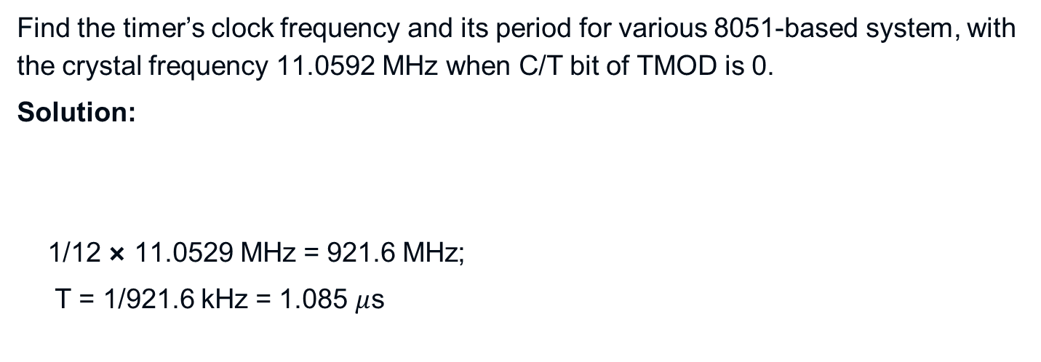
Find the timer’s clock frequency and its period for various 8051-based system, with the crystal frequency 11.0592 MHz when C/T bit of TMOD is 0.
Solution:
1/12 × 11.0529 MHz = 921.6 MHz;
T = 1/921.6 kHz = 1.085 $μ$s

Slide 24
Indicate which mode and which timer are selected for each of the following.
(a) MOV TMOD, #01H (b) MOV TMOD, #20H (c) MOV TMOD, #12H
Solution:
We convert the value from hex to binary. From Figure 9-3 we have:
(a) TMOD = 00000001, mode 1 of timer 0 is selected.
(b) TMOD = 00100000, mode 2 of timer 1 is selected.
(c) TMOD = 00010010, mode 2 of timer 0, and mode 1 of timer 1 are selected.

Slide 25
Find the value for TMOD if we want to program timer 0 in mode 2,
use 8051 XTAL for the clock source, and use instructions to start and stop the timer.
TMOD = 0000 0010

Slide 26
TCON Register
TCON (timer control) register is an 8-bit register, used to control operations of counter and timers in microcontrollers.

Slide 27
TMOD Register --GATE
Timers of 8051 do starting and stopping by either software or hardware control
In using software to start and stop the timer, GATE=0
The start and stop of the timer are controlled by way of software by the TR (timer start) bits TR0 and TR1 of TCON register
The SETB instruction starts it, and it is stopped by the CLR instruction
These instructions start and stop the timers as long as GATE=0 in the TMOD register
The hardware way of starting and stopping the timer by an external source is achieved by making GATE=1 in the TMOD register

Slide 28
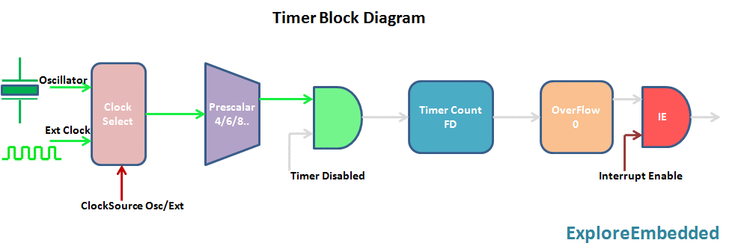
The timer is a simple binary counter that can be configured to count clock pulses(Internal/External).
Once it reaches the Max value, it will roll back to zero setting up an OverFlow flag and generates the interrupt if enabled.
https://exploreembedded.com/wiki/images/6/69/Timer.gif

Slide 29
Timer Calculation
8051 Oscillator frequency is divided by 12 and then fed to the controller, Time to increment the Timer count by one(timer tick) can be determined as below. tick = (1/(Fosc/12) For F_{osc} == 11.0592Mhz, the tick time will be 12/11.0592M = 1.085 us
Now the Timer value for the required delay can be calculated as below. Delay = TimerCount * tick Count = (Delay/tick) RegValue = TimerMax - Count RegValue = TimerMax - (Delay/tick) = TimerMax - (Delay/1.085us) RegValue = TimerMax - ((Delay/1.085) * 10^6)

Slide 30
Mode 1 Programming
The following are the characteristics and operations of mode1:
1. It is a 16-bit timer; therefore, it allows value of 0000 to FFFFH to be loaded into the timer’s register TL and TH
2. After TH and TL are loaded with a 16-bit initial value, the timer must be started
This is done by SETB TR0 for timer 0 and SETB TR1 for timer 1
3. After the timer is started, it starts to count up until it reaches its limit of FFFFH

Slide 31
Mode 1 Programming
3. When it rolls over from FFFFH to 0000, it sets high a flag bit called TF (timer flag)
– Each timer has its own timer flag: TF0 for timer 0, and TF1 for timer 1
– This timer flag can be monitored
When this timer flag is raised, one option would be to stop the timer with the instructions CLR TR0 or CLR TR1, for timer 0 and timer 1, respectively
4. After the timer reaches its limit and rolls over, in order to repeat the process 􀂃 TH and TL must be reloaded with the original value, and TF must be reloaded to 0

Slide 32
Timer Mode1
The timer in Mode-1 can be used as a 16-bit timer to generate a wide range of delay
The timer value for the required delay needs to be loaded into Timer Count registers TH & TL
Timer Calculation for 50ms delay
Fosc = 11.0592Mhz Delay = 50ms RegValue = TimerMax - ((Delay/1.085) * 10^6)
RegValue = 65536 - (50ms/1.085)*10^6 = 65536 - 46082 = 19453 = 0x4BFD
Timer starts counting up and once it reaches the max value(0xffff)
it rolls back to zero setting the overflow flag. At this point, the timer values must be reloaded and the overflow flag should also be cleared.

Slide 33
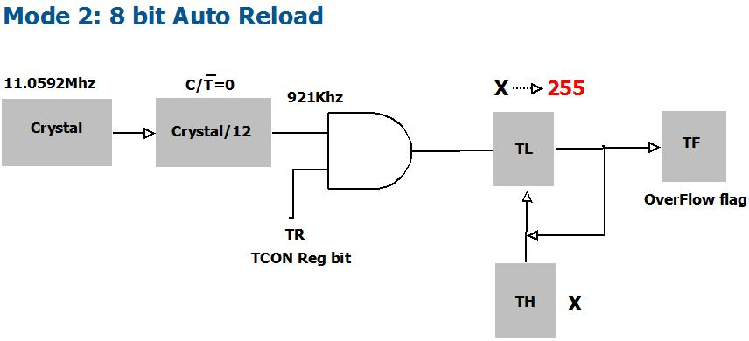
Timer Mode 2
The timer in Mode-2 can be used as an 8-bit timer to count from 00 to FFH .
The timer value for the required delay needs to be loaded into Timer Count registers TH(which is copied to TL).
After loading the values to the register, the timers must be started.
Now the Timer starts incrementing TL and once it reaches the max value(0xff), it rolls back to zero setting the overflow flag and reloads the value from TH.

Slide 34
Timer Calculation for 250µs delay
F_{osc} = 11.0592Mhz
Delay = 250µs
RegValue = TimerMax-((Delay/1.085) * 10^6)
RegValue = 256 - (250µs/1.085)*10^6 = 256 - 230 = 26 = 0x1A
void main()
{
TMOD = 0x02; //Timer0 mode 2
TH0 = 0X1A; //Load the timer value
TR0 = 1; //turn ON Timer zero
ET0 = 1; //Enable TImer0 Interrupt
EA = 1; //Enable Global Interrupt bit
while(1)
{
// Do nothing
}
}
#include<reg51.h>
sbit LED = P0^0;
void timer0_isr() interrupt 1
{
LED =! LED; // Toggle the LED pin,
//Note Timer value is not reloaded, It is automatically taken care
}

Slide 35
Polling Method
#include<reg51.h> sbit LED = P0^0; void timerDelay() { TH0 = 0X4B; //Load the timer value TL0 = 0XFD; TR0 = 1; //turn ON Timer zero while(TF0 == 0); // Wait for Timer Overflow TF0 = 0; //clear the timer Over flow flag TR0 = 0;
void main()
{
TMOD = 0x01; //Timer0 mode 1
while(1)
{
LED = 1;
timerDelay();
LED = 0;
timerDelay();
}
}

Slide 36
Interrupt method
The interrupt method makes use of a register called Interrupt Enable (IE) register.
An 8051 microcontroller has 6 hardware interrupts.
The interrupts refer to a notification, communicated to the controller, by a hardware device or software, on receipt of which controller skips temporarily whatsoever it was doing and responds to the interrupt.
The controller starts the execution of an Interrupt Service Routine (ISR) or Interrupt Handler which is a piece of code that tells the processor or controller what to do on receipt of an interrupt.
After the execution of ISR, controller returns to whatever it was doing earlier (before the interrupt was received).

Slide 37

Timer interrupts
Two interrupts are set aside for the timers:
one for timer 0 and one for timer 1
A timer interrupt informs the microcontroller that the corresponding Timer has finished the counting.
INTERRUPT REGISTER

Slide 38
Interrupt Method
#include <reg51.h>
sbit LED = P0^0;
void timer0_isr() interrupt 1
{
TH0 = 0X4B; //Reload the timer value
TL0 = 0XFD;
LED = ! LED; // Toggle the LED pin
}
void main()
{
TMOD = 0x01; //Timer 0 mode 1
TH0 = 0X4B; //Load the timer value
TL0 = 0XFD;
TR0 = 1; //turn ON Timer zero
ET0 = 1; //Enable TImer0 Interrupt
EA = 1; //Enable Global Interrupt bit
while(1)
{
// Do nothing
}
}

Slide 39
To generate time delay
1. Load the TMOD value register indicating which timer (timer 0 or timer 1) is to be used and which timer mode (0 or 1) is selected
2. Load registers TL and TH with initial count value
3. Start the timer
4. Keep monitoring the timer flag (TF) with the JNB TFx,target instruction to see if it is raised
Get out of the loop when TF becomes high
5. Stop the timer
6. Clear the TF flag for the next round
7. Go back to Step 2 to load TH and TL again

Slide 40
Example
In the following program, we create a square wave of 50% duty cycle (with equal portions high and low) on the P1.5 bit. Timer 0 is used to generate the time delay. Analyze the program
MOV TMOD,#01 ;Timer 0, mode 1(16-bit mode)
HERE: MOV TL0,#0F2H ;TL0=F2H, the low byte
MOV TH0,#0FFH ;TH0=FFH, the high byte
CPL P1.5 ;toggle P1.5
ACALL DELAY
SJMP HERE
DELAY:
SETB TR0 ;start the timer 0
AGAIN: JNB TF0,AGAIN ;monitor timer flag 0
;until it rolls over
CLR TR0 ;stop timer 0
CLR TF0 ;clear timer 0 flag
RET
In the above program notice the following steps.
1. TMOD is loaded.
2. FFF2H is loaded into TH0-TL0.
3. P1.5 is toggled for the high and low portions of the pulse.

Slide 41
4. The DELAY subroutine using the timer is called.
5. In the DELAY subroutine, timer 0 is started by the SETB TR0 instruction.
6. Timer 0 counts up with the passing of each clock, which is provided by the
crystal oscillator. As the timer counts up, it goes through the states of FFF3,FFF4, FFF5, FFF6, FFF7, FFF8, FFF9, FFFA, FFFB, and so on until it reaches FFFFH. One more clock rolls it to 0, raising the timer flag (TF0=1).
At that point, the JNB instruction falls through.
7. Timer 0 is stopped by the instruction CLR TR0. The DELAY subroutine ends, and the process is repeated.
Notice that to repeat the process, we must reload the TL and TH registers, and
start the process is repeated

Slide 42
COUNTERS

Slide 43
Applications of counters
Frequency counters.
Digital clocks.
Analog to digital convertors.
With some changes in their design, counters can be used as frequency divider circuits
In time measurement

Slide 44
Counters and Timers
Timer | Counter
The register is incremented for every machine cycle. | The register is incremented considering 1 to 0 transition at its corresponding to an external input pin (T0, T1).
Maximum count rate is 1/12 of the oscillator frequency. | Maximum count rate is 1/24 of the oscillator frequency.
A timer uses the frequency of the internal clock, and generates delay. | A counter uses an external signal to count pulses.

Slide 45
COUNTER PROGRAMMING
Timers can also be used as counters counting events happening outside the 8051
When it is used as a counter, it is a pulse outside of the 8051 that increments the TH, TL registers
TMOD and TH, TL registers are the same as for the timer discussed previously
Programming the timer in the last section also applies to programming it as a counter
Except the source of the frequency

Slide 46
COUNTER PROGRAMMING C/T Bit in TMOD Register
The C/T bit in the TMOD registers decides the source of the clock for the timer
When C/T = 1, the timer is used as a counter and gets its pulses from outside the 8051
The counter counts up as pulses are fed from pins 14 and 15, these pins are called T0 (timer0 input) and T1 (timer 1 input)

Slide 47
Assuming that clock pulses are fed into pin T1, write a program for counter 1 in mode 2 to count the pulses and display the state of the TL1 count on P2, which connects to 8 LEDs.
Solution:
MOV TM0D,#01100000B ;counter 1, mode 2,;C/T=1 external pulses
MOV TH1,#0 ;clear TH1
SETB P3.5 ;make T1 input
AGAIN: SETB TR1 ;start the counter
BACK: MOV A,TL1 ;get copy of TL
MOV P2,A ;display it on port 2
JNB TF1,BACK ;keep doing, if TF = 0
CLR TR1 ;stop the counter 1
CLR TF1 ;make TF=0
SJMP AGAIN ;keep doing it
Since ports are set up for output when the 8051 is powered up,
we make P3.5 an input port by making it high.
In other words,
we must configure (set high) the T1 pin (pin P3.5) to allow
pulses to be fed into it.

Slide 48
COUNTER PROGRAMMING TCON Register
TCON (timer control) register is an 8-bit register, used to control operations of counter and timers in microcontrollers.

Slide 49
COUNTER PROGRAMMING TCON Register
TCON register is a bit-addressable register

Slide 50
COUNTER PROGRAMMING TCON Register
If GATE = 1, the start and stop of the timer are done externally through pinsP3.2 and P3.3 for timers 0 and 1,respectively
This hardware way allows to start or stop the timer externally at any time via a simple switch

Slide 51
COUNTER PROGRAMMING C/T Bit inTMOD Register
Assuming that clock pulses are fed into pin T1, write a program for counter 1 in mode 2 to count the pulses and display the state of the TL1 count on P2, which connects to 8 LEDs.
MOV TM0D,#01100000B ;counter 1, mode 2,;C/T=1 external pulses
MOV TH1,#0 ;clear TH1
SETB P3.5 ;make T1 input
AGAIN: SETB TR1 ;start the counter
BACK: MOV A,TL1 ;get copy of TL
MOV P2,A ;display it on port 2
JNB TF1,Back ;keep doing, if TF = 0
CLR TR1 ;stop the counter 1
CLR TF1 ;make TF=0
SJMP AGAIN ;keep doing it
Notice in the program the role of the instruction .
Since ports are set up for output when the 8051 is powered up,
we make P3.5 an input port by making it high.
In other words,
we must configure (set high) the T1 pin (pin P3.5) to allow pulses to be fed into it.

